Slide 1
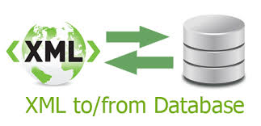

XML
Team Members:
Keerthi Chiduruppa
Pavithra Devdas
Karunakar Reddy Katasani
*Northwest logo taken from northwest website
* Northwest logo taken from Northwest Missouri website

Slide 2
INTRODUCTION
Pavithra Devdas
XML is an evolving benchmark for interchanging and presenting any data.
Storing and querying the XML represented documents is bit of a problem.
Therefore this paper presents a single query processor which can be used with all relation schema generation techniques
Several techniques were used to build native XML database systems.
Step one is generating relational schema.
Second step is shredding of XML documents.
Third step is processing the query.

Slide 3
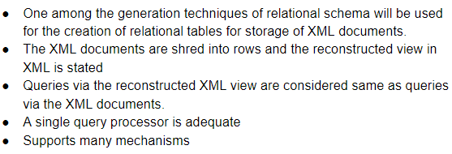
Keerthi Chiduruppa
PROPOSED TECHNIQUE
One among the generation techniques of relational schema will be used for the creation of relational tables for storage of XML documents.
The XML documents are shred into rows and the reconstructed view in XML is stated
Queries via the reconstructed XML view are considered same as queries via the XML documents.
A single query processor is adequate
Supports many mechanisms
*Information taken from research paper “A General Technique for Querying XML Documents”.

Slide 4
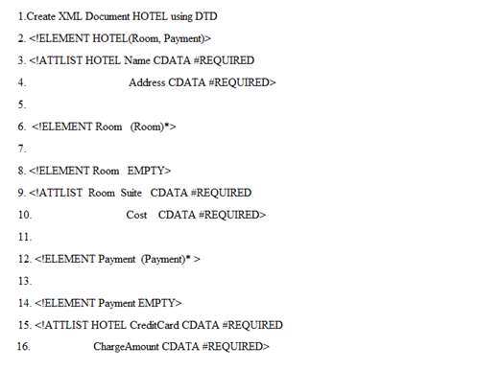
Keerthi Chiduruppa
Approach I
DTD’s are used to create appropriate relational tables.
XML documents DTD to be stored is specified in the
body definition.
Top-level element - “hotel”
“hotel” has two sub-elements and two attributes
“room” element can contain zero or more rooms
The two attributes of the room are “Suite” and “Cost”.
“room” has no sub-element
*Information taken from research paper “Relational Databases for Querying XML Documents”.

Slide 5
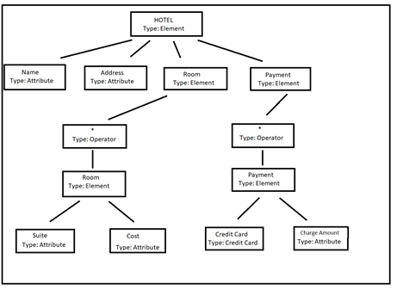
Keerthi Chiduruppa
Each node represents an XML element, attribute or an “operator”.
“*” operator which specifies that the sub-element can occur many times.
“*” specifies a unique relation.
DTD Graph

Slide 6
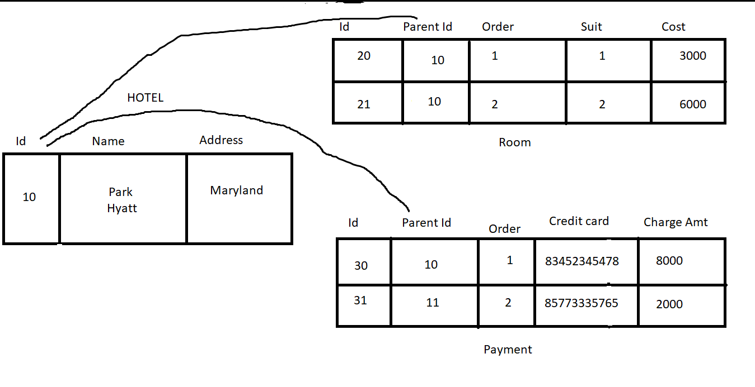
Keerthi Chiduruppa
There is an “id” field for each relation and is used as primary key.
“Room” and “Payment” have a “Parentid” field used as foreign key.
The siblings in the non-root elements
are ordered and are specified by “order” field.
Generated Relational Schema

Slide 7
Reconstruction of XML View
Pavithra Devdas
Reconstruction of XML document from the rows in the relation tables is done using a specific algorithm.
The algorithm performs a recursive traversing of the graph.
New tables are created for elements
No new tables are created for attributes
*Information taken from research paper “Relational Data as XML Documents”.

Slide 8
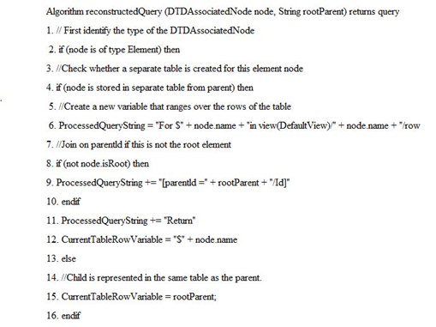
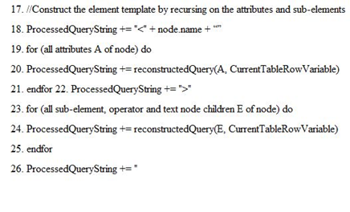
Pavithra Devdas
*Information taken from research paper “An efficient mapping scheme to bridge XML and relational database”

Slide 9

Edge Approach
The whole XML document is stored into a relational database.
The elements in XML are used to label the edges.
The information regarding the source node and the destination node of an edge in a XML tree are stored in an Edge table in the form of identifiers.
The Structure of this approach is:
Edge( source_Id, destination_Id, Ordinal, name, value, type).
E
Karunakar Reddy
*Information taken from journal “Model mapping approaches for XML documents”

Slide 10
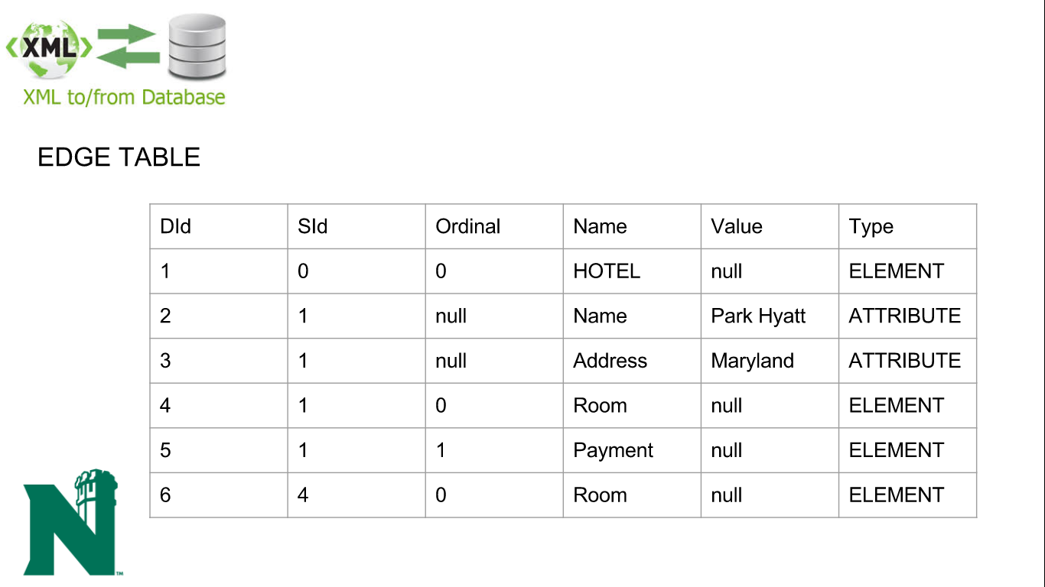
EDGE TABLE
Karunakar Reddy
DId | SId | Ordinal | Name | Value | Type
1 | 0 | 0 | HOTEL | null | ELEMENT
2 | 1 | null | Name | Park Hyatt | ATTRIBUTE
3 | 1 | null | Address | Maryland | ATTRIBUTE
4 | 1 | 0 | Room | null | ELEMENT
5 | 1 | 1 | Payment | null | ELEMENT
6 | 4 | 0 | Room | null | ELEMENT

Slide 11
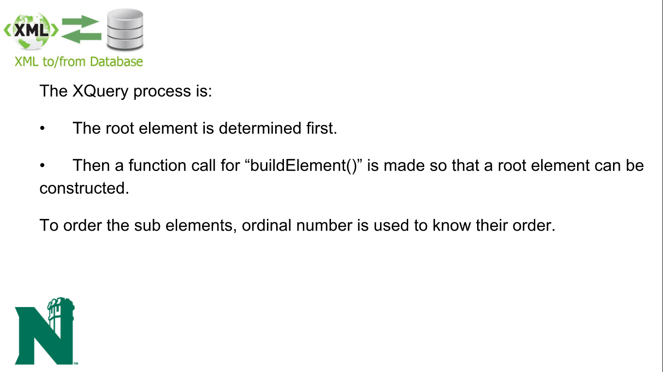
The XQuery process is:
• The root element is determined first.
• Then a function call for “buildElement()” is made so that a root element can be constructed.
To order the sub elements, ordinal number is used to know their order.
Karunakar Reddy

Slide 12
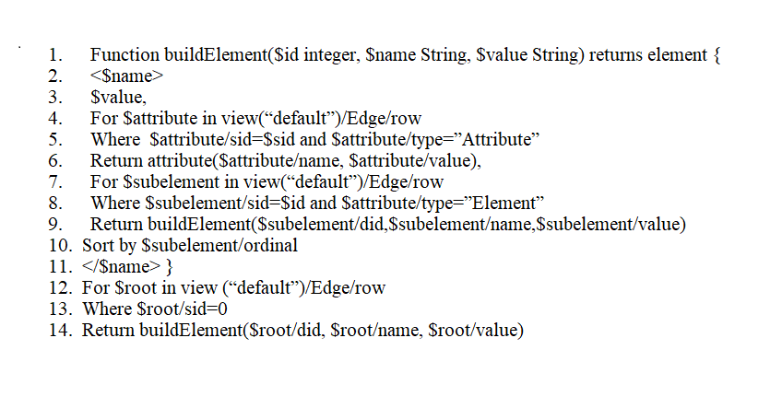
Karunakar Reddy
Reconstruction XML view:

Slide 13
Conclusion
Pavithra Devdas
Efficient technique for conversion of XML queries
Single query processor
Faster conversion of XML queries

Slide 14
References
Shanmugasundaram, J., Shekita, E., Barr, R., Carey, M., Lindsay , B., Pirahesh, H., & Reinwald, B. (2000). Efficiently Publishing Relational Data as XML Documents. vldb, 12.
Shanmugasundaram, J., Tufte, K., Gang He, Chun Zhang , Witt, D. D., & Naughton, J. (2000). Relational Databases for Querying XML Documents:. VLDB Conference. Cairo, Egypt.
Krishnamurthy , R., Shanmugasundaram, J., Shekita , E., Kiernan , J., Viglas , E., Naughton, J., & Tatarinov , I. (2001). A General Technique for Querying XML Documents. citeseerx, 30, 26.
Qtaish, A., & Ahmad, K. (2015). Model mapping approaches for XML documents: A review. journals.sagepub, 23.
Subramaniam, S., Su-Cheng Haw , & Poo Kuan Hoong. (2011). s-XML: An efficient mapping scheme to bridge XML and relational database. Knowledge-Based Systems, 11.
Su-Cheng Haw, & Chien-Sing Lee. (2011). Data storage practices and query processing in XML databases: A survey. ac.els-cdn, 24.

Slide 15


Slide 16
Thank you

